Slide 1



Older Adult Nutrition:
Practical Strategies
Sara Casey Fagan, RD, CSG, LDN
Director of Nutrition
Bringing New Life to Senior Living®
Notes:
GRAPHICS NOTE: This is a cover slide to be used at your discretion or preference. No text should be on this page.

Slide 2

Learning Objectives
Define ethics and identify ethical principles.
Explain ethical dilemmas in dementia care.
Identify tools for making ethical decisions.
Understand ethical principles through case examples.

Slide 3

Objectives
Describe the changes that occur to the body as we age and the nutritional implications in the older adult.
List the health consequences resulting from poor nutritional intake and strategies to improve eating habits and health status.
Identify the nutritional considerations for older adults with cognitive impairments.
Outline creative and practical strategies for ensuring adequate food intake in the older adult with dysphagia.

Slide 4
Nutritional Considerations for the Older Adult

Slide 5
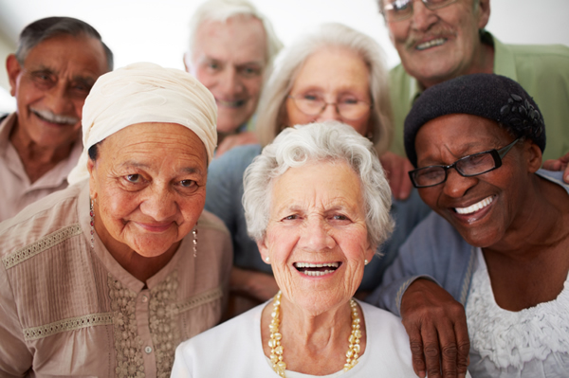
Nutrition and Aging

Slide 6
What’s the big deal?
FOOD IS ESSENTIAL COMPONENT OF EVERY DAY LIFE
Add meaning and structure
Feelings of independence and control
Sense of security
Food habits are influenced by lifetime preferences as well as living arrangements, finances, transportation, disability, etc.

Slide 7
Factors of Nutrition and Aging
Aging | Chronic Disease | Psycho-Social
Decreased food intake | Inflammatory response of disease increases calorie and protein requirements | Isolation and loss of autonomy
Weight loss | Polypharmacy compounds drug nutrient interactions | Grief/loss
Loss in muscle mass and strength (sarcopenia) | Changes in appetite and metabolism | Depression/anxiety
Changes in oral health and eating ability | 87% of older adults have hypertension, diabetes or heart disease | Food insecurity/decreased ability to obtain or prepare foods
Slower gastrointestinal processes | Diet prescription by diagnosis restricts food

Slide 8
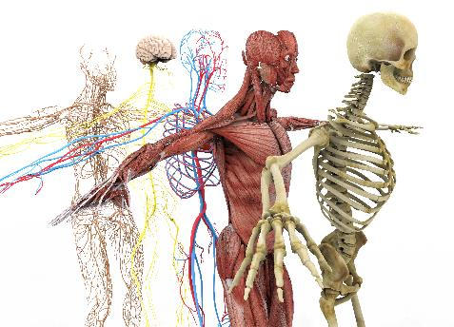
Physiological Changes
Muscles
Skeletal System
Cardiovascular System
Body Composition

Slide 9
Body Composition and Aging
Muscle Mass
Body Fat
Between age 30-60, average adult will gain 1 lb fat weight and lose 1/3 lb muscle annually.
30 lb fat gained and 15 lb muscle lost!
After age 70, muscle loss accelerates by 15% per decade

Slide 10
Body Composition and Aging
MEANING:
Reductions in muscle mass, bone density, immune function and nutrient absorption and metabolism may make it difficult for older adults to meet nutrition requirements, especially when energy needs are reduced.
Altered muscle metabolism
Sarcopenia
Impaired physical function
Increased disability

Slide 11
Lean Body Mass (LBM)
Body Weight
- Body Fat
= Lean Body Mass
Can a person be overweight but
depleted of lean body mass?

Slide 12
Lean Body Mass (LBM)
Body Weight
- Body Fat
= Lean Body Mass
Can a person be overweight but
depleted of lean body mass?
YES

Slide 13
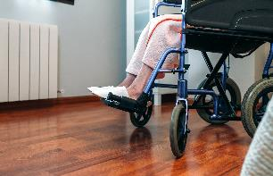
Cycle of Nutrition Problems
Poor Intake
Weight Loss Nutritional Deficiency
↓Func. Status ↑Falls ↑Death
Frailty, ↑ Hospital, ↑ LOS
Increased Risk of Illness and Infection

Slide 14
Nutritional Priorities
Weight Maintenance
Nutritional Density is Key
Calories, Protein, Fat
Vitamins and Minerals
Phytochemicals: Antioxidants

Slide 15
Nutritional Strategies for Calories and Protein

Slide 16
Calorie Recommendations
3500 Calories = 1 Pound!
Age | Calories
50-70 yr. | 1800-2000
<70 yr. | 1800-2000
Total and resting energy requirements decrease progressively with age - attributed largely to the decline in physical activity.

Slide 17
Protein Recommendations
Recommendation | g protein/kg body weight/day
RDA | 0.8
EAR | 0.66
AMDR | 10-35% of total energy intake
What about older adults?

Slide 18
Protein Recommendations
Recommendation | g protein/kg body weight/day
RDA | 0.8
EAR | 0.66
AMDR | 10-35% of total energy intake
What about older adults?
1.0-2.0
g/kg BW/day

Slide 19
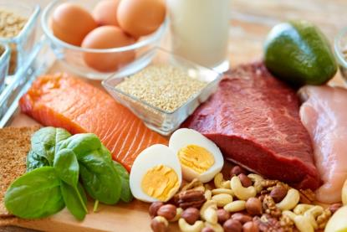
Diet Strategies
Food First
Nutrient Dense Foods
Food Fortifiers
Oral Supplements & Modulars
Meal Planning

Slide 20
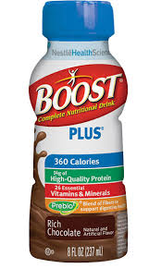
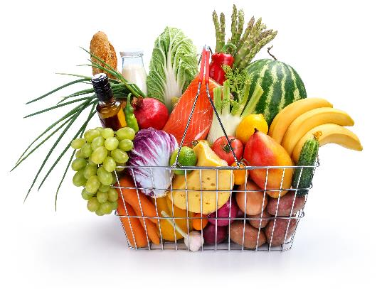
Supplements vs Food

Slide 21
Supplements vs Food
Acceptable | Generally Not Acceptable
Underweight/ significant weight loss | Inconsistent with preferences/goals
Eating < 50% of meals | Willing to accept double portions
Medical conditions | As a meal replacement
Always Individualized

Slide 22
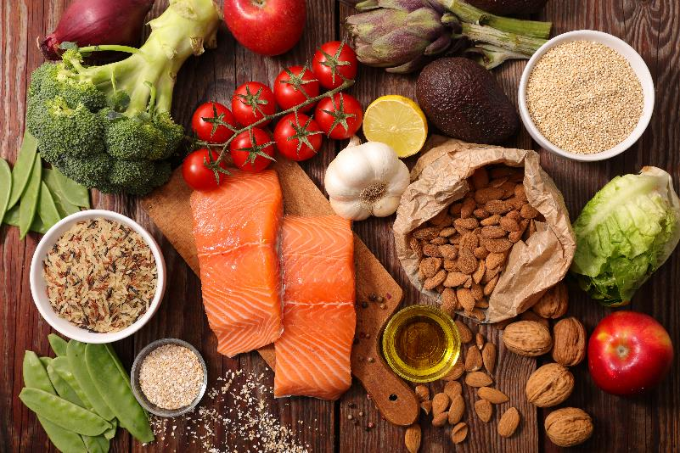
Food First

Slide 23
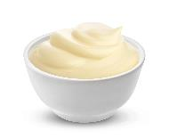
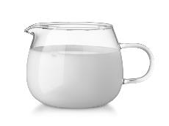
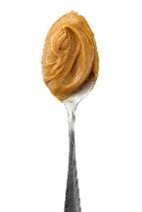
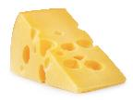
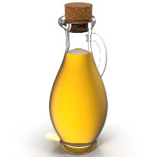
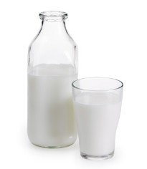
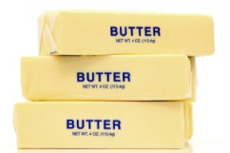
Food Fortification
MAXIMIZE NUTRIENT DENSITY!

Slide 24
Food Fortifiers
Butter
Margarine
Mayonnaise
Peanut butter
Cream
Half & half
Olive oil
Honey
Whole Milk
Milk powder
Syrup
Cheese
Jelly
Salad dressing
Pasteurized egg whites
Sour cream

Slide 25
Diet Strategies
Use milk instead of water to prepare hot cereals
Add non-fat dry milk to soup, pudding, eggs, casseroles
Add cheese or eggs to vegetables, salads, potatoes, rice, noodles
Consider Greek yogurt as a snack or breakfast addition
Add peanut butter to toast, crackers, muffins or use as a dip
Add nuts or seeds to breads, muffins, pancakes, cookies, cereal, ice cream, yogurt or use in place of breadcrumbs
Add hard boiled eggs to salads
Add beans or lentils to soups, casseroles or salads
Add extra olive oil when cooking lean meats, veggies, stir fries or soups
Food First
Nutrient Dense Foods
Food Fortifiers
Oral Supplements & Modulars
Meal Planning

Slide 26
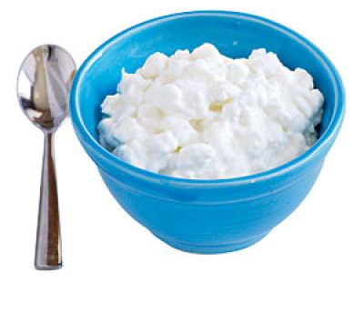
Nutrient Dense Foods
½ cup cottage cheese
92 calories & 11 g protein

Slide 27
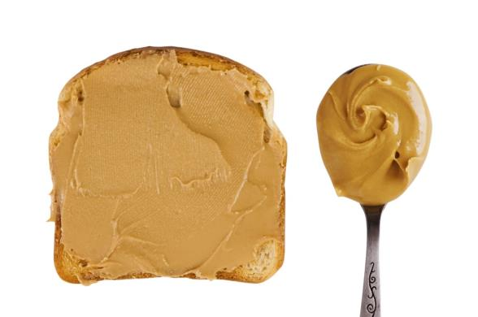
Nutrient Dense Foods
REMEMBER TO COMBINE WITH FOOD
2 tablespoons peanut butter
191 calories & 7 g protein

Slide 28
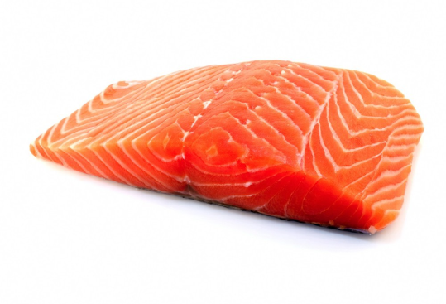
Nutrient Dense Foods
4 oz salmon
161 calories & 22 g protein

Slide 29

Nutrient Dense Foods
½ cup vanilla ice cream
250 calories & 4 g protein

Slide 30
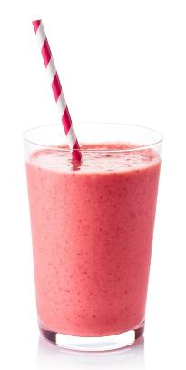
Nutrient Dense Foods
Homemade shakes and smoothies
>400 calories and >10 g of protein

Slide 31
Chocolate, Banana, Peanut Butter Smoothie
Food | Calories | Protein
1 cup whole milk (or plain yogurt) | 149 | 7.7
1 Tablespoon peanut butter | 96 | 3.5
2 Tablespoon chocolate syrup | 133 | 1.75
1 banana | 105 | 1.3
3 ice cubes | - | -
483 calories, 14 g protein

Slide 32
Nutritional Strategies for Dementia

Slide 33

Nutrition and Dementia
Under-nutrition is common among people with dementia.
Tends to be progressive, with weight loss.
Often precedes diagnosis by a decade or more.
Increases in pace across the disease course.
Mechanisms underlying weight loss and under-nutrition are complex, multifactorial and only partially understood.
CAN and SHOULD be avoided.

Slide 34
Nutrition and Dementia
RECOMMENDATIONS:
Monitor weight and assess nutritional status regularly
Receive nutrition assessment/dietary advice from a dietitian when:
Screened to be at risk or malnourished
As condition evolves (update care plan)
With onset of weight loss
With the onset of feeding behavior expressions and/or need for feeding assistance

Slide 35
Dining Room Environment
Suboptimal Mealtime Behaviors
Agitation
Decreased Meal Intake
Chaotic Dining Room

Slide 36
Dining Room Considerations
Appearance/Size
Furniture
Tablemates
Vision/Lighting
Noise
Staff
Tableware
Wait time
Seating Arrangement

Slide 37
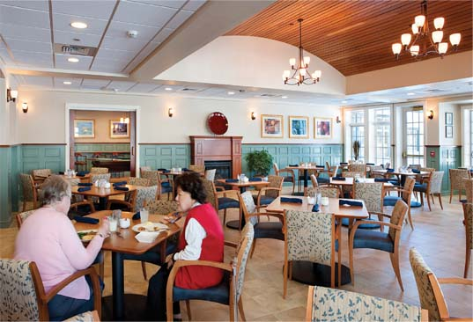
Dining Room Considerations
What do you notice about this dining room?

Slide 38
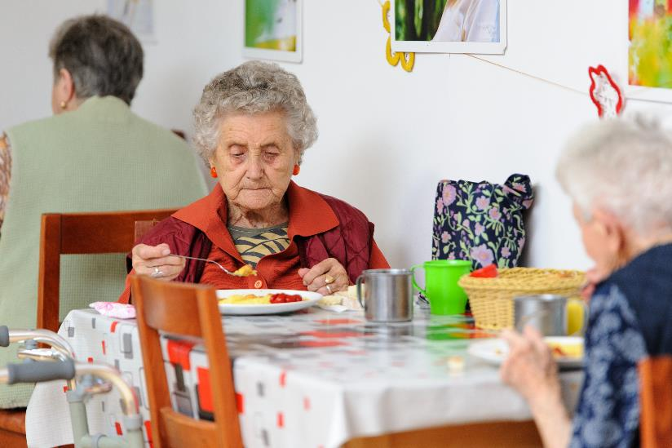
Dining Room Considerations
What do you notice about this dining room?

Slide 39
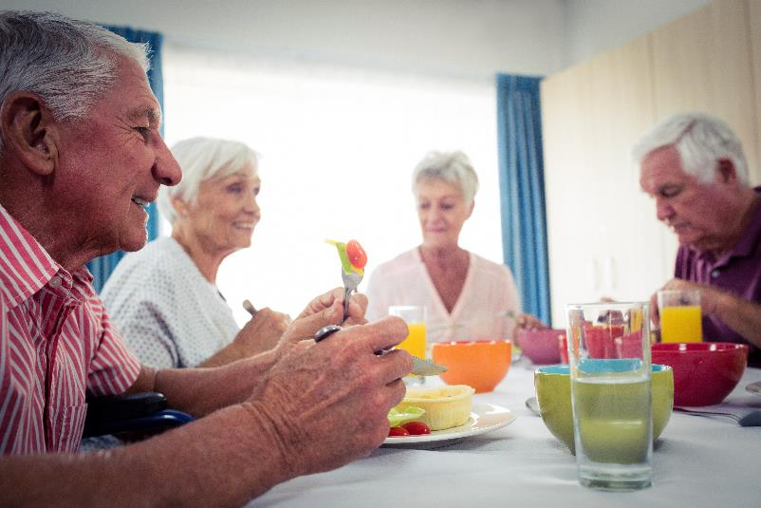
Dining Room Considerations
What do you notice about this dining room?

Slide 40
Distractions
Distraction Free Tables
Simple table settings
Bowls of fake fruit can be confusing
No elaborate center pieces or floral arrangements
Salt and pepper shakers can be confusing

Slide 41
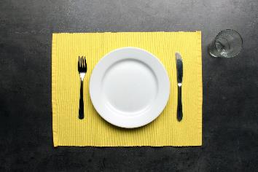
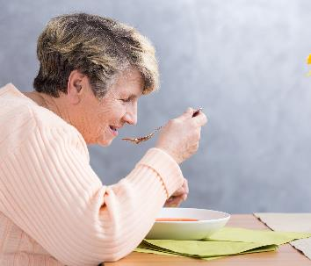
Visuals
Dementia can cause changes in visual and spatial abilities
Stick to solid colored plate and placemats as florals and patterns can be distracting
COLOR: Reds, greens and browns are popular food colors likely to stimulate appetite and van help with visibility

Slide 42
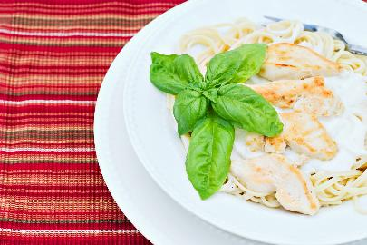
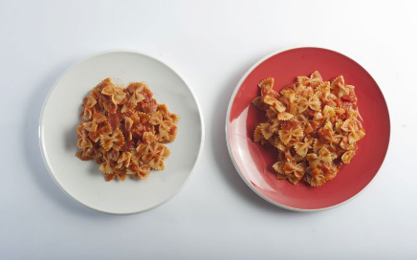
Visuals
Distinguish food from plate
High contrast bright colors

Slide 43
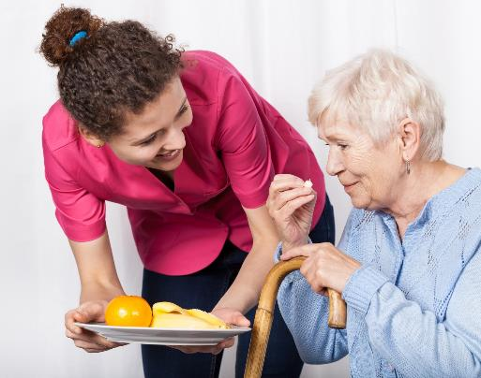
Food Preferences
Flexibility is key!
Favorites and preferences may change.
Choices are important, however can be overwhelming.
Repeatedly asking about the same meal is OK.
Keep in mind what you say and how you say it.

Slide 44
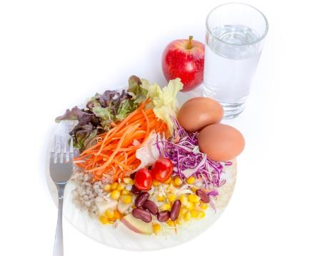
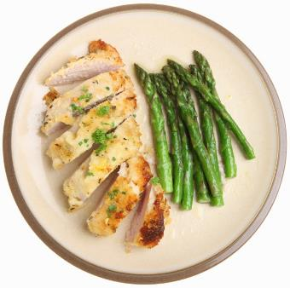
Portion Size
Large portion sizes can be overwhelming
Try serving only 1-2 foods at a time
Don’t forget about food temperatures!

Slide 45
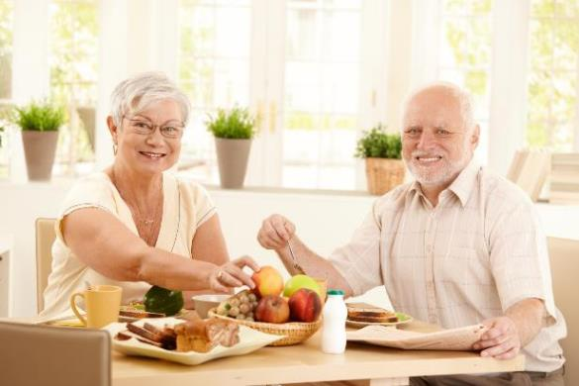
Timing
Don’t assume stoppage in eating means the person is done; it may be difficult to concentrate.
Provide extra time and prompting to assist.
Eat together.
People with dementia tend to take in the most calories at the mid day meal as that is the time of day when cognition tends to be best

Slide 46
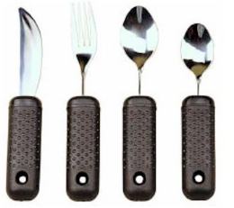
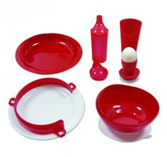
Assistive Tableware and Utensils
Don’t worry about making a mess – Let them eat!
Rubber placemat or suction cups
Non slip handles or cuff for gripping
Rubber coated foods for those that bite down on utensils
Plates with rim or edge for scooping
Rocket knives
Divided plates
Two handled mugs

Slide 47
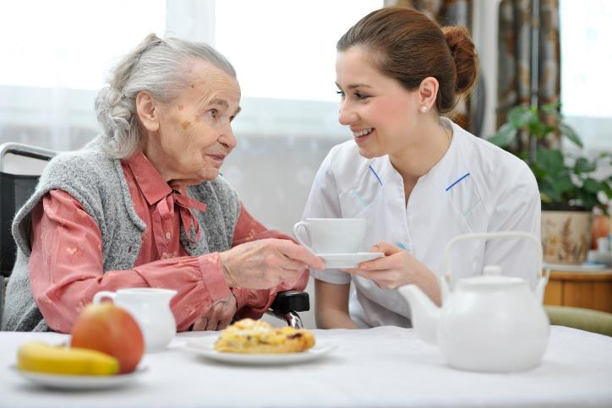
Controlling Behavioral Expressions

Slide 48
Controlling Behavior Expressions
Shaking head no at food
Ignore negative behavior and avoid direct conflict, encouraging the person to eat all the food on their place
Sucking reflexes, sucking fingers preventing food from entering the mouth
Keep hands busy, holding book or soft item to prevent the behavior
Continuous chewing and spit rather than swallow
Change food texture to semi-liquids
Pacing
High chairs, with trays to help prevent wandering
Won’t open mouth
Touch cheek with cold spoon to help open
Verbal encouragement, eye contact, relaxing music, additional assistance should also be considered.

Slide 49
Nutritional Strategies for Finger Foods

Slide 50
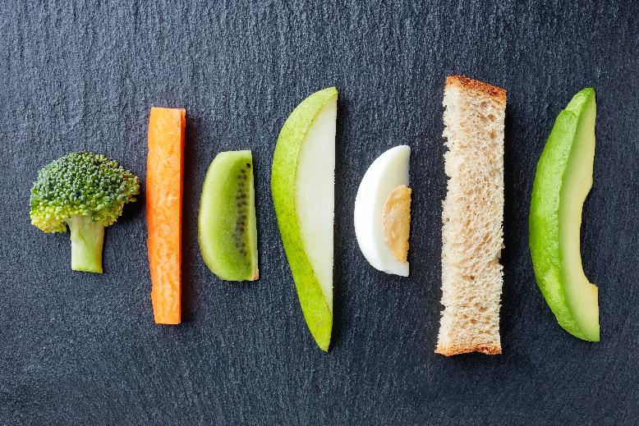
Finger Food Strategies

Slide 51
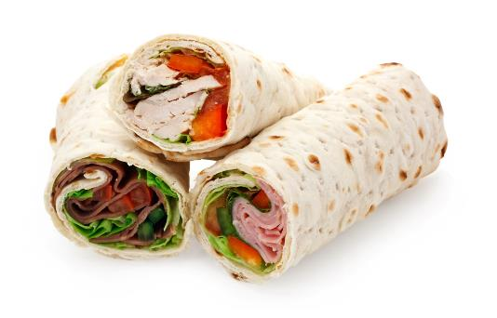
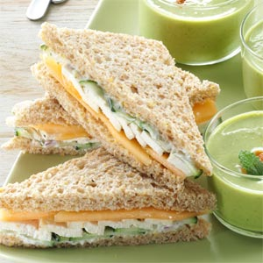
Sandwiches: Cut, Wrapper & Rolled
Use foods other than bread including pitas, tortillas, flatbread

Slide 52
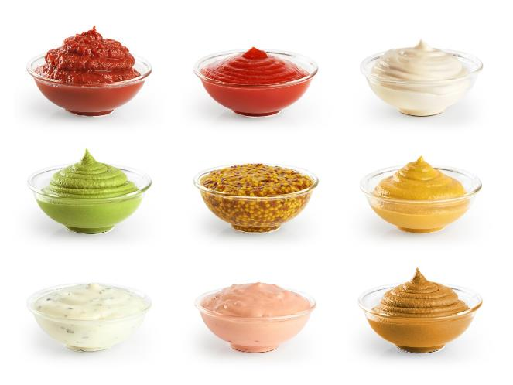
Sauces and Condiments
Flavor, variety and calories!

Slide 53
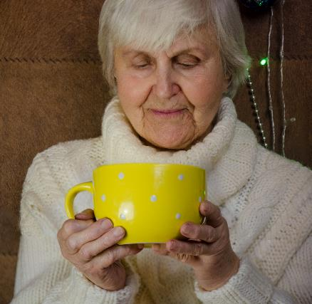
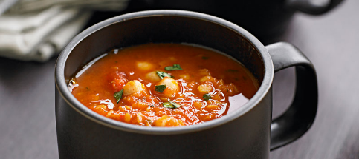
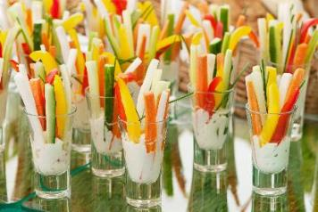
Mugs & Cups
½ inch pieces!

Slide 54
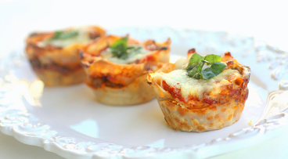
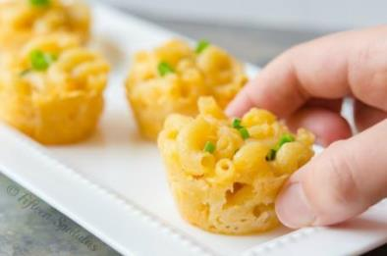
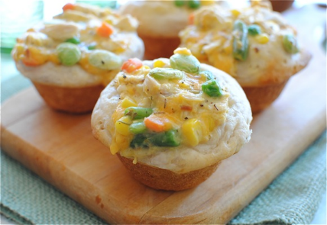
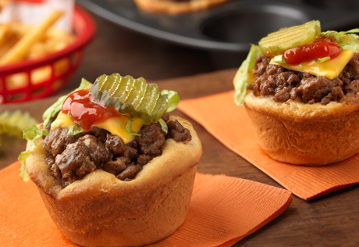
Muffins and Cupcakes

Slide 55
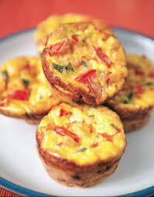
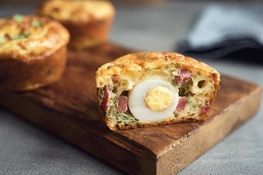
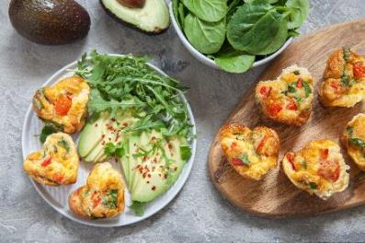
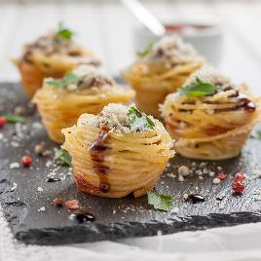
Muffins and Cupcakes

Slide 56
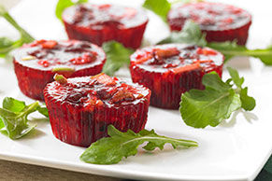
Gelatin Salads

Slide 57
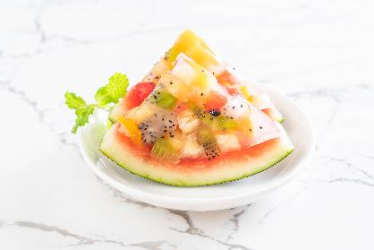
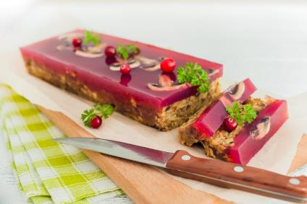

Gelatin Salads

Slide 58



Spreads, Purees and Toppings
Bottom Line: BE CREATIVE!

Slide 59
Audience Challenge
See if you can go one whole day without using any utensils.
Use some of these ideas to create something you’ve never tried before!

Slide 60
Nutritional Strategies for Pureed Foods

Slide 61

IDDSI – Coming 2019

Slide 62
Chewing and Swallowing Problems
Healthy older adult swallowing vs dysphagia
Puree
Smooth
Homogenous
Texture Modified
Moist
Cohesive
Soft-textured
Easily formed into bolus
Excludes need for bolus formation

Slide 63



Naturally Pureed Food
Applesauce
Hummus
Tomato sauce
Cream of Rice/Cream of Wheat
Ice cream
Mashed bananas
Gelatin

Slide 64
Foods Not Allowed
Potatoes
Apples
Corn
Fresh Grapes
Bacon
Caramel
Nuts
Dried Fruits
Sprinkles
Seeds
Raisins
Chocolate Chips
Coconut
Fresh Pineapple
Clams
Pears
Acorn Squash
Fresh Oranges

Slide 65

Puree Preparation
Prepare one food at a time
Keep hot foods hot and cold foods cold
Remember: moist, cohesive, spoon thick
Blenders are not recommended as they’re not as powerful and requires too much liquid

Slide 66
Tips for Consistency
Too Runny?
Too Sticky?
Too Dry?
Traditional food thickeners
Adding fat such as butter, sour cream, gravy can help
Add flavorful liquids like milk, gravy or broth
Try baby rice thickener, canned pureed beans like chickpeas or mashed potato flakes, cracker crumbs, bread crumbs

Slide 67
Tips for Serving
Layering
Piping
Molding
Basting adds color to proteins
Combine shapes and textures
Gelled
Garnishing
Sauces
Flavored oils
Unique bowls and plates
Temperature
Avoid the “smiley face”

Slide 68


Tips for Serving
Foods that do not puree well:
Corn, bacon, dried fruit, nuts

Slide 69




Brookdale Puree Training

Slide 70
Brookdale Puree Training
Treat purees with the same passion as you would with preparing a meal for residents on a regular diet!

Slide 71
Nutritional Strategies for Texture Modified Foods

Slide 72

Texture Modified Food
Moist, soft textured and easily formed into bolus
No large chunks
No bones or skins
Not necessary to add liquids
Garnishes like cheese and canned fruit slices
Gravies and sauces
Remember to grind beef patties and other foods made from ground meats

Slide 73
Texture Modified Food
Soft moistened breads
Hot cereals
Tender meat with gravy
Eggs
Cheese
Soft peeled fruits (including canned fruits)
Peeled potatoes
Soft well cooked vegetables
Ice cream
Soft cookies and cakes
Shredded lettuce
Cooked dried beans and legumes
Plain yogurt with small pieces of fruit
DO include

Slide 74
Texture Modified Food
Bacon
DO NOT include
Corn
Clams
Grapes
Tough, stringy fruit (e.g. pineapple)
Nuts
Large or hard seeds (e.g. raspberries, poppy seeds, sunflower seeds)
Raisins or dried fruit
Sprinkles
Coconut
Hard Chocolate Chips

Slide 75

YOU CAN BE SUCCESSFUL!

Slide 76

Notes:
GRAPHICS NOTE: This is a final slide to be used at your discretion or preference. No text should be on this page.

